Slide 1
New Jersey
Department of Human Services
New Jersey Department of Human Services
Office of Program Integrity and Accountability
DHS Licensed provider Report Card
January 23, 2023

Slide 2
Background
The Department of Human Services Office of Program Integrity and Accountability (OPIA) has compiled and publically posted a Risk Management Report since 2009
OPIA assembles the data it collects to create a quarterly “indicator report” - utilizing performance data from each provider agency across various DHS systems, including licensing, investigations and critical incident reporting. This enhances transparency and enables the public to assess provider strengths.

Slide 3
Background
In 2021, the Risk Indictor Report was redesigned and updated to reflect current trends in data collection and analysis.
Families and the general public criticized that the report was too technical and did not achieve its goal of allowing the public to assess provider strengths.
Licensed provider agencies gave feedback that the report was punitive.

Slide 4
DDD Licensed Provider Report Card
On February 1, 2023 OPIA will publish the newly redesigned user friendly “DHS Licensed Provider Report Card”. Some of the features of the Report Card are:
Outcome and strengths based; as opposed to risk areas, outcomes, such as meeting health and safety standards, are measured.
Better performing agencies are easily identified. A colored star system makes it easy to see how well an agency is meeting the outcomes.
A redesigned Companion Guide describes outcomes in plain speak, elaborates on scoring metrics and defines terms.
The Report Card was positively received by both families and providers.

Slide 5
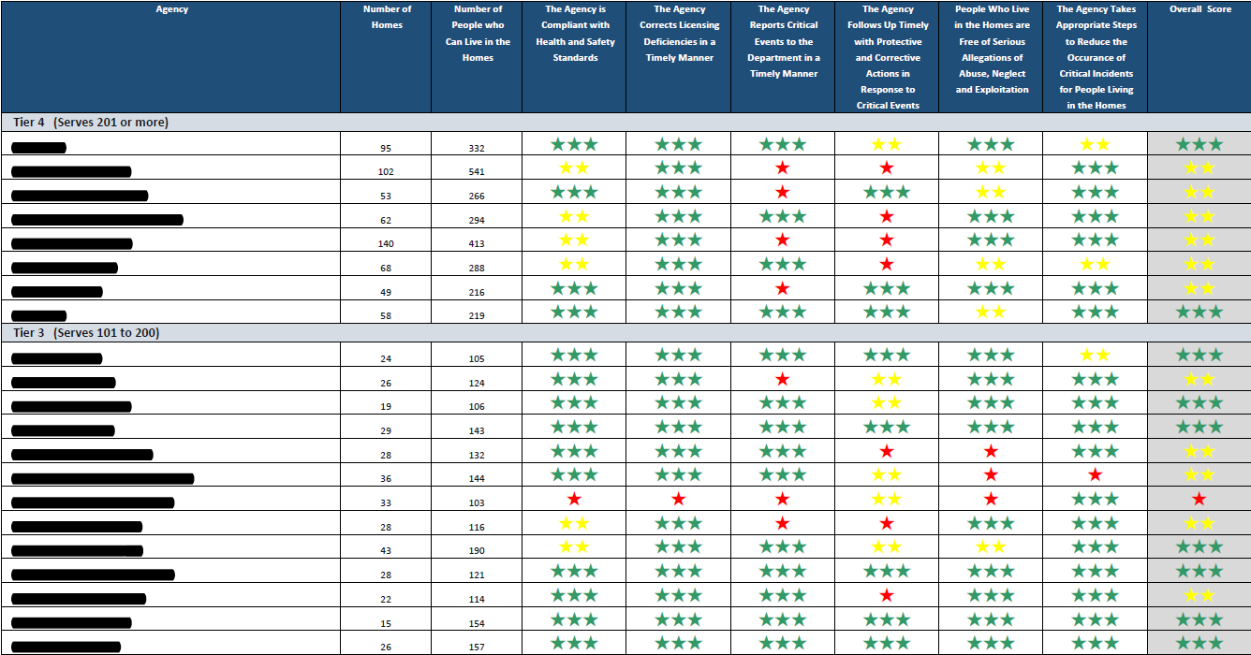
PREVIEW

Slide 6
Auditing
Auditing columns have been removed
DHS is not the cognizant Department for many licensed providers, creating an imbalance
May have given a misleading impression about an agency's financial health
DHS is exploring other ways to be transparent, while providing helpful information

Slide 7
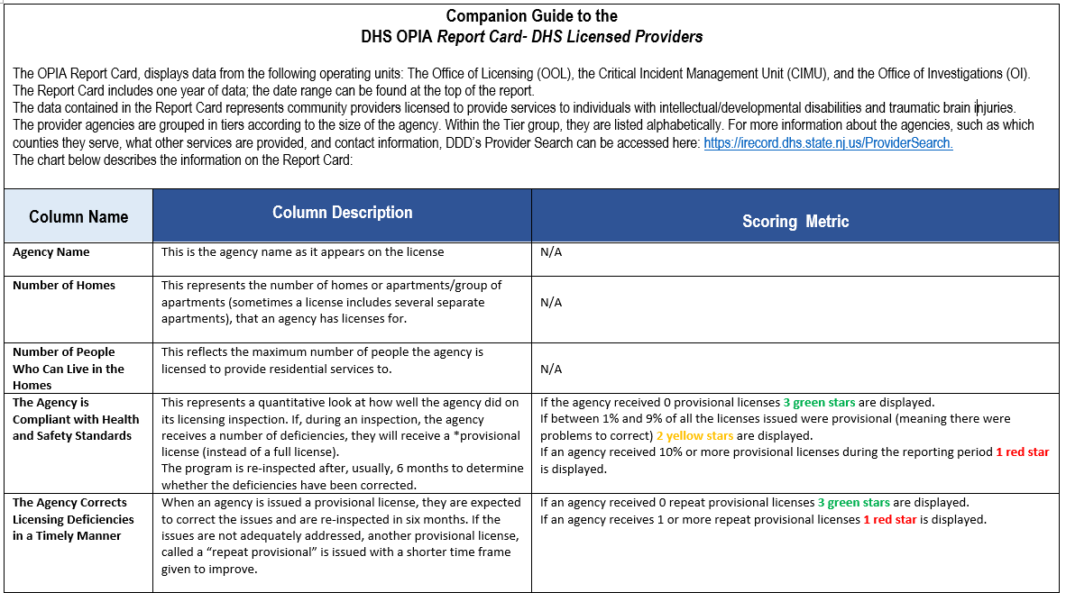
Companion Guide

Slide 8
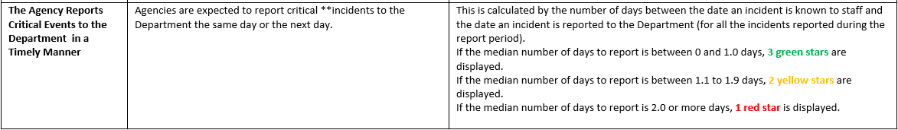
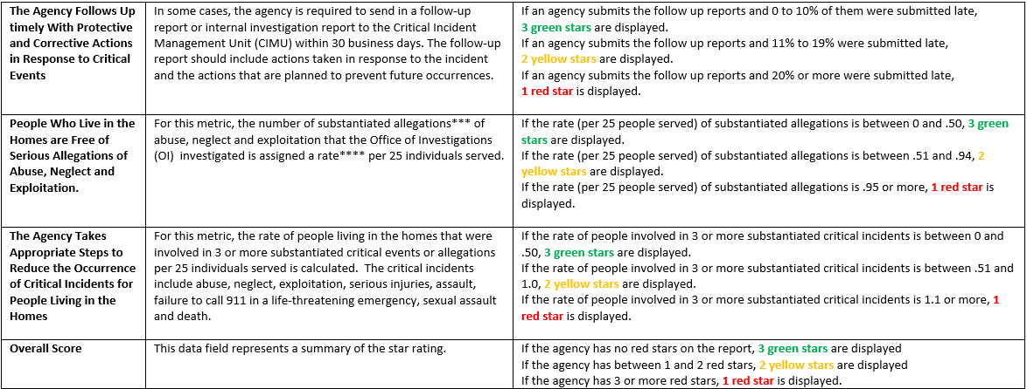
Companion Guide

Slide 9
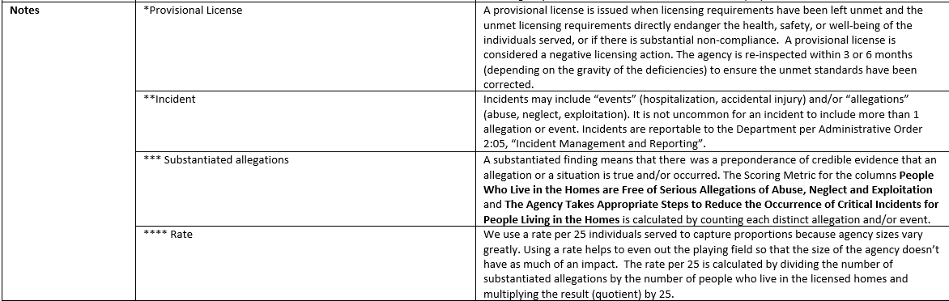
Companion Guide

Slide 10
For Licensed Providers
DDD Licensed providers will continue to receive an advance copy of the report along with the underlying data relative to their agency’s performance.
The data will be presented in the current format.
Auditing data will be included as an FYI

Slide 11
Questions/Comments
Questions-
DHS-OPIA-RISKMANAGEMENT@dhs.nj.gov
On February 1, 2023 the Report card will be posted at
Department of Human Services | DHS Risk Management System (state.nj.us)

